Slide 1
Science Fiction Becomes Reality: Emerging Threats in our Connected World

Slide 2
A quick introduction
Who are the ATR?
The Advanced Threat Research (ATR) team in Intel Security discovers opportunities to drive toward more secure technology. http://www.intelsecurity.com/advanced-threat-research/
Jesse Michael
has been working in security for over a decade and spends his time annoying Mickey and finding low-level security vulnerabilities in modern computing platforms.
Mickey Shkatov
Aside from loving to bother Jesse with everything he does, Mickey’s areas of expertise include vulnerability research, hardware and firmware security, and embedded device security.

Slide 3
Agenda
Introduction
What does this mean?
Technology landscape at home
Elements → Threats → Example
Technology landscape on the road
Elements → Threats → Example
Technology landscape at work
Elements → Threats → Example
Thank you
Q&A

Slide 4

Introduction
We live in a new world where smart devices are everywhere and more and more types of connected devices are joining the world internet every day!
These devices are slowly becoming an integral part of our lives, the next generation is already adept at new technology after growing up using smart phones, what about the generation after that?
It looks like everything will be connected eventually.
http://deliveringhappiness.com/wp-content/uploads/2011/10/happyball.jpg

Slide 5

Introduction negative
Everything is connected
Everything has vulnerabilities
Everything will get compromised at some point
https://s-media-cache-ak0.pinimg.com/236x/5c/4d/a5/5c4da51186f1b8eb4dc5a0d55f413ffa.jpg

Slide 6

What does this mean?
Should we all be paranoid and worry?
This results in new types of threats and scenarios most folks have yet to consider
But for your enjoyment, we have thought of a few. Here are some advanced threat scenarios involving the future ransomware in our connected world:
https://regmedia.co.uk/2016/01/11/afraid_of_the_dark_image_via_shutterstock.jpg?x=648&y=348&crop=1

Slide 7
Technology landscape at home

Slide 8

At home - Elements
We have smart appliances
Smart fridge
Connected slow cooker
We have intelligent assistants
Amazon Echo, Dash, Tap, etc.
We have remote control
Belkin WeMo product line
Logitech Circle
Nest Thermostat and Camera
Every other cloud connected and plugged in device you can think of
We have security systems
Comcast in the US for example
https://www.colourbox.com/preview/7505847-man-standing-on-the-edge-and-looking-down.jpg

Slide 9

At home - Threats
Peeping toms
Stalking/harassment
Surveillance
Foothold inside your home network, past your firewall.
Bot – as a part of a large botnet
Ransomware
Cause damages. Maybe a prank? Maybe not.
Get you out of the house and rob it
Get into your house and rob it
http://www.zwp-online.info/sites/default/files/teaserbild/beruf_zahnarzt_england.png

Slide 10
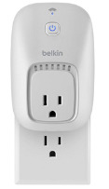
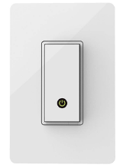
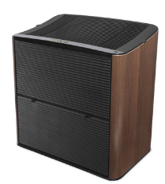
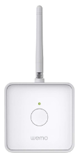
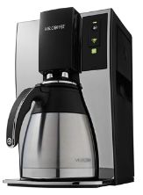
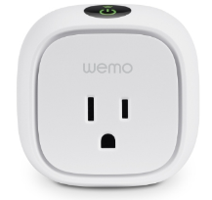
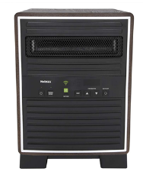
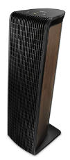
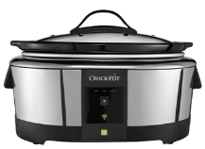
At home - Example
Belkin WeMo
WEMO Firmware released 5/16/2016
Affected devices:
Switch
Sensor
Insight (v1, v2)
Light Switch
Link
Maker
Slow Cooker
Air Purifier
Humidifier
Heater
Coffee Maker
http://www.belkin.com/us/Products/home-automation/c/wemo-home-automation/

Slide 11
Explanation
Vulnerability description
Attacker send a request to the device to save a new (and very long) device name.
Device saves the name in NVRAM and responds – success.
Attacker sends a request to get the device name.
Device retrieves the name from NVRAM and a buffer is overrun with the name previously provided.
http://www.belkin.com/us/Products/home-automation/c/wemo-home-automation/

Slide 12
Demo

Slide 13
Technology landscape on the road

Slide 14
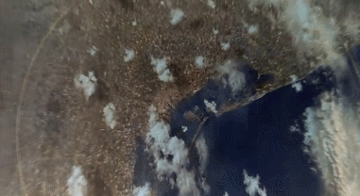
On the road - Elements
Connected cars
Nissan Leaf
Self driving cars
Tesla
Uber
Comma AI
Smart intersections - smart cities.
After market
In vehicle infotainment
ECU
CAN bus gateways
http://i.imgur.com/XB0kRsy.gif

Slide 15
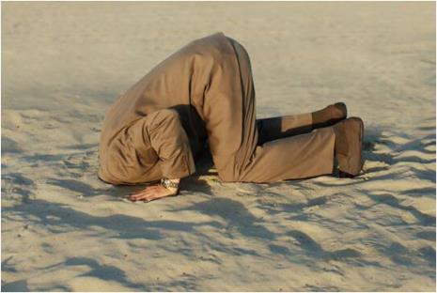
On the road - Threats
Mischief
Burglary
Car theft
Espionage
Assassinations
Terror attacks
https://adelannoy.files.wordpress.com/2014/12/projet5.jpg

Slide 16
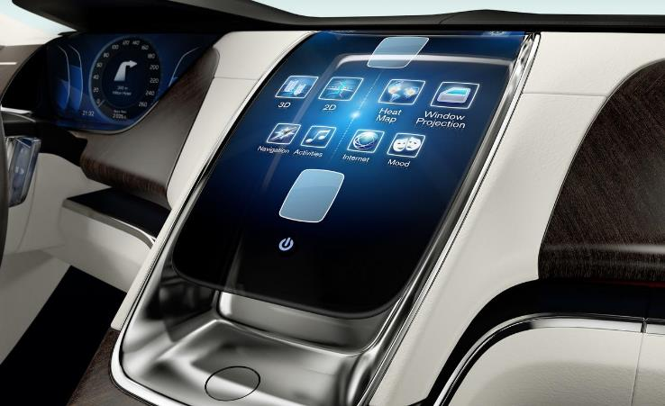
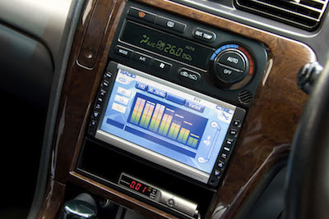
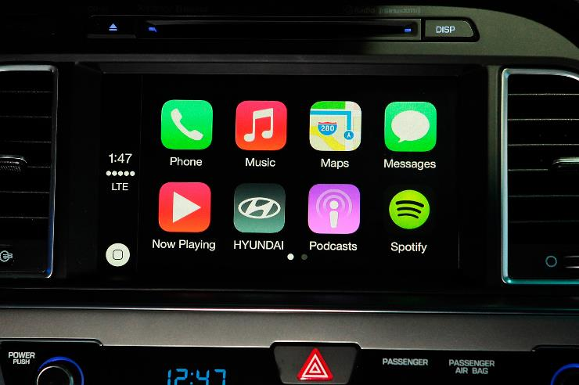
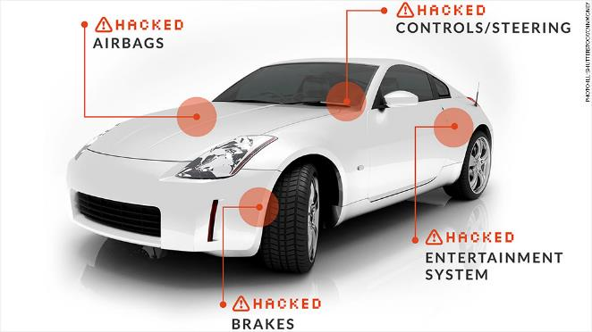
On the road - Example
http://www.spidersweb.pl/wp-content/uploads/2013/11/volvo-concept.jpg
In vehicle infotainment
http://knaulrace.com.br/v/wp-content/uploads/2014/07/embedded-android-dashboard.jpg
http://nnews.no/wp-content/uploads/2015/03/carhack-1024x576.jpg
http://st.motortrend.com/uploads/sites/5/2015/11/Infotainment-system-In-car-apps.jpg

Slide 17
Explanation
For this particular device, 2 vulnerabilities were disclosed to the vendor
This in vehicle infotainment system is running an outdated android version that is susceptible to a known exploit.
It was also built using the android test-keys , which allows anyone to create their own malicious apk , sign it with the publicly known test-keys and install it on the system without any issue.

Slide 18
Demo

Slide 19
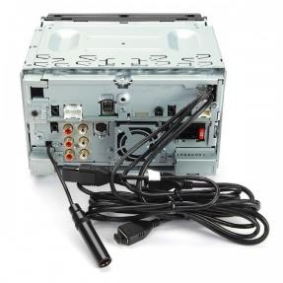
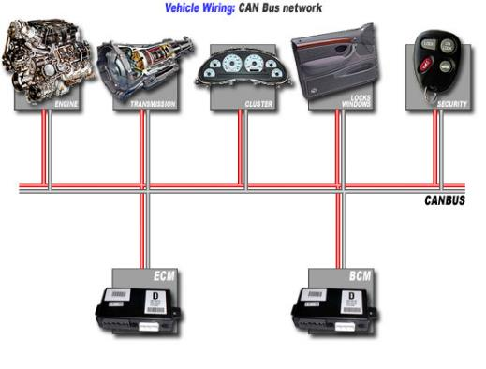
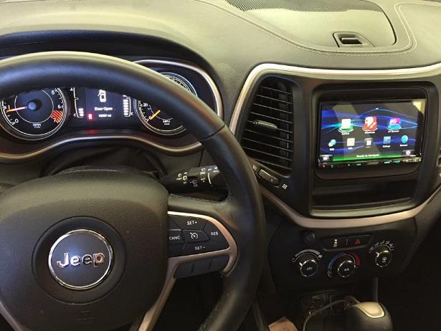
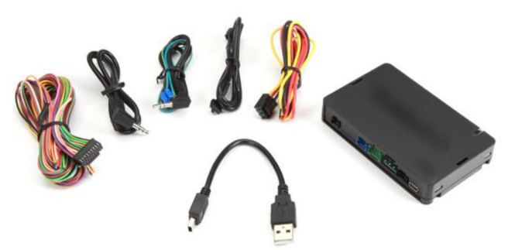
Explanation
http://images2.crutchfieldonline.com/ImageHandler/fixedscale/100/100/products/2015/8/113/x113DNN992-o_back.jpg
http://automotrizenvideo.com/wp-content/uploads/2013/10/canbus-767x582@2x.jpg
http://www.caraudiolovers.com/wp-content/uploads/2016/03/Jeep-Cherokee-Radio.jpg
http://images.crutchfieldonline.com/ImageHandler/trim/620/378/products/2015/30/794/g794ADSMRR-F.jpg

Slide 20
Technology landscape at work

Slide 21
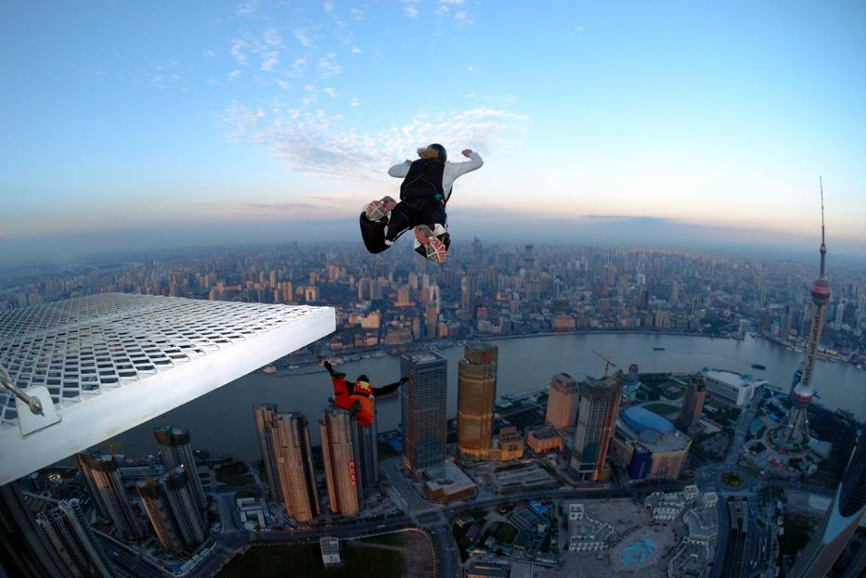
At the office - Elements
Smart whiteboards
Video conferencing and screen sharing
Many kinds of wireless capabilities
Charging
WPC/Qi, PMA, A4WP
Display
WiDi, Miracast, Airplay
Docking
WiGig
Printing
USB
http://www.erneuerbareenergien.de/files/smthumbnaildata/1500x/4/7/3/7/2/9/04SHANG4963.jpg
Notes:
If we want to or not, we are heading twards a true wire free world whee all our tech will be wireless based.

Slide 22

At the office - Threats
All of the threats from home plus more
Economic espionage
Insider trading based on stolen non-public business information
Industrial espionage
Theft, modification, or destruction of intellectual property
Sabotage of business operations
http://www.channelweb.co.uk/IMG/576/269576/man-with-head-in-sand.jpg

Slide 23
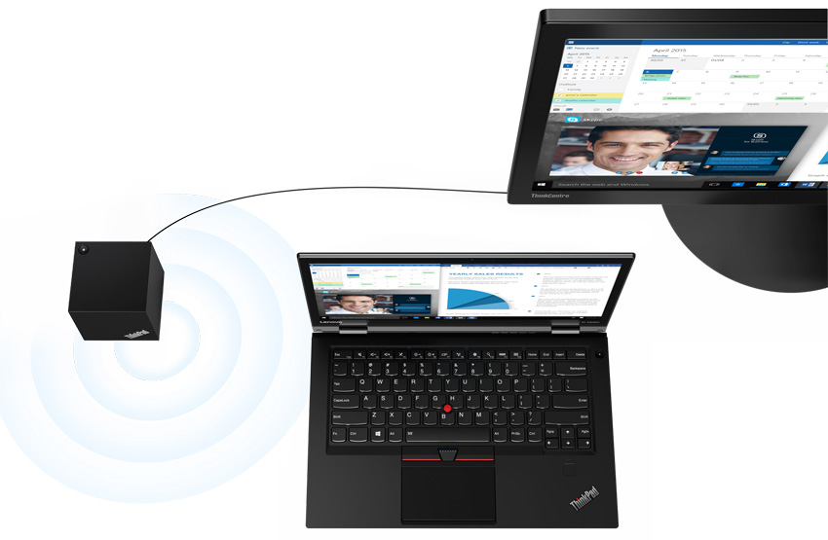
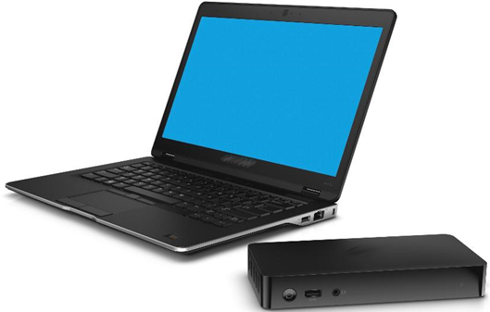
At the office - Example
WiGig wireless docking
https://ait-hiscek5qw.netdna-ssl.com/wp-content/uploads/2016/01/ThinkPad-X1-Carbon1.png
http://dosisgadget.com/wp-content/uploads/2013/03/Dell-Wireless-Dock-wigig.jpg

Slide 24
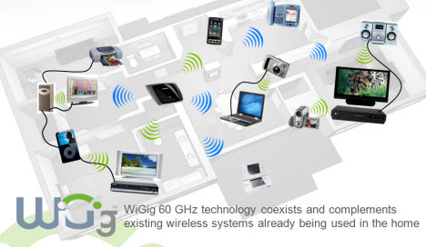
At the office - Example
WiGig wireless docking
https://www.baboo.com.br/wp-content/uploads/2013/01/WiGig1.jpg

Slide 25
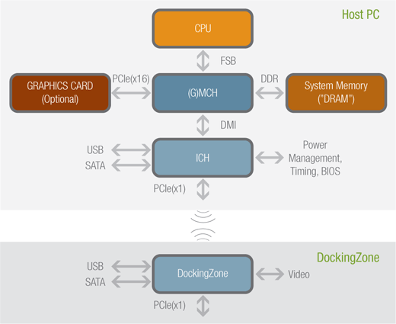
At the office - Example
http://tpholic.com/xe/files/attach/images/60/139/636/005/dockingzone-il.png

Slide 26
Explanation
In this case we have a broad spectrum of vulnerabilities
The wireless dock does not support secure firmware update, any firmware can be uploaded to the device.
The software service required to be run on any laptop using this particular docking station has an insecure update mechanism that can allow an remote attacker to gain elevated system privileges.
We repurposed a legitimate docking station to be a malicious docking station that will allow us to perform a DMA attack using the Inception tool and dump user physical memory.

Slide 27
Demo

Slide 28
Explanation

Slide 29
Recommendations

Slide 30
Reducing the risks
Be mindful of devices that are not under your control.
Practice good information security policies even inside networked environments.
Be aware of the risks in connecting your car to the internet.
Keep your systems patched and up to date as much as possible.
Watch for IOC and do not depend on the vendor to keep you safe.

Slide 31
Once compromised
Be ready to make hard choices, if systems/devices are no longer maintained or patched.
Try to perform a hard reset and restore pre-compromised state – if possible.
Look for other IOC in the rest of your environment.
See something say something.

Slide 32
Changing industries
Architect devices with compromise in mind.
Consider the broader implications of the compromise of your device.
Secure update mechanism is a must and not a recommendation.
Remember, compromise == bad.
Sometimes it can be a safety issue (Car, Health care, ICS).

Slide 33
Thank you very much
ありがとうございました

